Slide 1

All topic summary Lecture Note
Notes:
Oromia State University Dep't of IT Data comm.&computer NWs by: Abebe D.

Slide 2
Introduction
What is Data communication?
Communication model (e.g. Human communication)
Source
  Generates data
Transmitter
  Converts data into transmitting signals
Transmission system
  Carries data
Receiver
  Converts received signals into data
Destination
  Takes incoming data

Slide 3
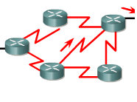
Communication model in networks
Source
Transmitter
Receiver
Destination
Transmission
system

Slide 4
Data Representation
Text
  Represented in bits patterns e.g. 0,1
  Different Bit patterns called code.
  Present Coding system: Unicode, 32 bits
Numbers
  Represented in bit patterns
  Converted into binary for calculations
Images
  Represented into matrix of pixels/bits
Audio/Video
  Continuous data

Slide 5
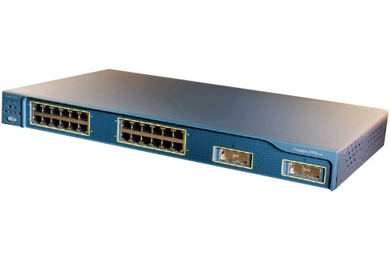
Flow of Data
Simplex
  One way traffic only, one device transmits and one receives e.g. Keyboard->monitor
Half-duplex
  Both stations can transmit and receive but one at time. e.g. Bus topology
  Only one path from source to destination.
  collisions may occur
Full-duplex
  Both can receive and send at the same time. e.g. Star topology.
  Two separate transmission lines.
  collisions free

Slide 6
Networks
Nodes interconnected together and share information and resources.
Types of Network
  Point to point connections
  Circuit switching network
  Message switching network
  Packet switching network
Notes:
Hello

Slide 7

Point to point connections
Not peer to peer
Dedicated communication circuit
Fixed configuration
Direct link between devices
B and C can be intermediate device to connect A and D
Connection formed in different sections between users, end to end connection in series and forms circuit.
So point to point forms simple connection
If number of users increased then hard to provide circuit that connects each user with other users.
So we need switching which could provide sharing of transmission circuits.

Slide 8
Circuit switching network
This allows the communication circuits to be shared among users.
E.g. Telephone exchange
Switching
It allows equipments and circuits to be shared among users.
Establishes dedicated circuit between users before communication.
When circuit is free other users can use this. e.g. telephone calls.
Telephone exchange is an example of circuit switching.
Replacement conference calls

Slide 9
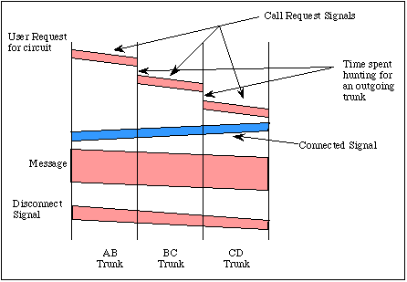
Circuit switching network
Source connects with switching node
User requests circuit
Node B recieves connection request
and identify path to node D via intermediate
node C.

Slide 10
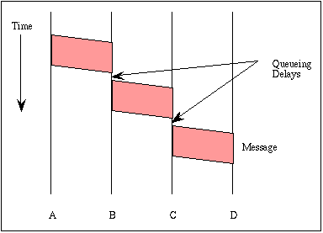
Message switching network
Circuit setup, store and forward e.g. Telex or email
Also called stored and forward switching
Not necessary to establish circuit between A and D.
When circuit is free it delivers otherwise waits and store message.
But delays may occur.

Slide 11
Packet switching network
Similar to message switching
but divides message into packets/datagram packets of equal lengths.
Headers are added to each packets.
Header contains information about source and destination.
No need for dedicated circuit.
As length of packet is small so each link is established for small time and then it is available for other messages.
Another benefit is pipelining.

Slide 12
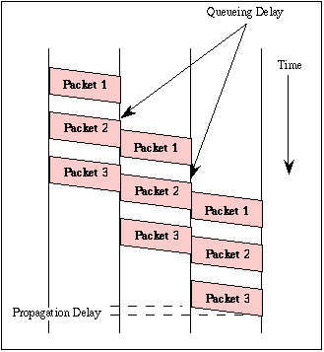
Packet switching network
Pipelining:
When data sent from B to C at the
same time data packet is being sent
from A to B.
This results in gain of efficiency. And
total delay for the transmission of
Message is very less.

Slide 13
Types of Packet switching network
LANs
WANs
ISPs
(will be discussed in detail once we set strong base for these networks)

Slide 14
Physical Topologies
Difference between Network topology and physical topology.
Network Topology: Defines structure of network
Physical topology: Layout of the wire or media.
But physical topology is a part of network topology.
Physical topology:
  BUS
  Star
  Ring
  Mesh
  Tree

Slide 15
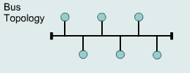
BUS
Uses single backbone cable, All hosts directly connected to this backbone.
Inexpensive and easy to install
All nodes receives data
Ends terminated with a device terminator.
Two types of BUS
  Linear
    All nodes connected to common medium which has only two end points.
  Distributed
    All nodes connected to common medium which has more then two end points.

Slide 16
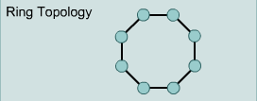
RING
All nodes connected to one another in form of closed loop.
Expensive and difficult to install but offers high bandwidth, not robust.
Point to point connection with only two devices.
Signal is passed in one direction only, moves until it reaches to its destination.
Each device connected with a repeater.
One signal always circulates for fault detection. If device don’t receives signal for specified time it generates alarm.

Slide 17
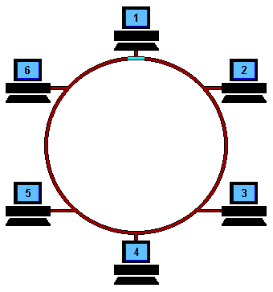

Slide 18
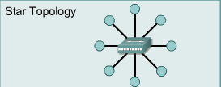
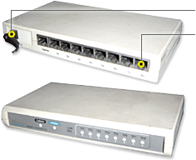
STAR
Connects all devices with central point.
Central point can be hub.
Data transmitted reaches to central point, who decides where to send data.
Bottleneck occur because all data pass from hub.
Less expensive and easy to install, robust if one link is down still remains active.
Disadvantage: dependency one central unit.
Star is used in LANs

Slide 19
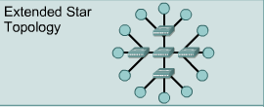
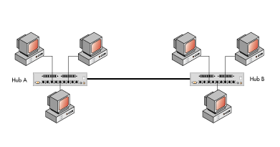
Types of STAR Topology
Extended STAR
  Has one or more repeaters from central node to extend maximum transmission distance.
  If repeaters in extended star topology is replace with hub or switches then it creates Hybrid topology.
  Or if backbone as star topology and extended with bus then it also creates Hybrid topology.
  Connecting two or more topologies with each other forms hybrid topology.
Distributed STAR
  Individual networks based on
  star topology
  These networks do not have central
  or top level connection points.

Slide 20
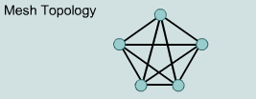
MESH
Each host has its dedicated point to point link with every other host.
Link only carries data between two devices only (no other can use that link)
If there are n number of nodes in network then we need n(n-1) links.
If link is multi directional or duplex mode then we need n(n-1)/2 links.
Each device requires n-1 I/O ports to be connected to each device.
Eliminates traffic problem, Robust, privacy/security of message.
More cabling required, more I/O ports needed, hard to install, expensive.

Slide 21
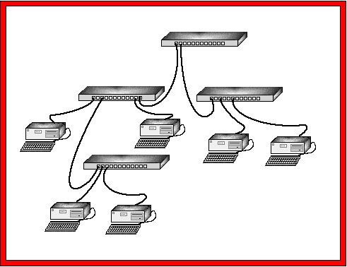
TREE
Central node connected to one or
more nodes one level lower in
hierarchy.
Combines characteristics of linear bus and star topology.
Must have three levels of hierarchy.
If only two levels then it forms star.
If branching factor one then linear hierarchy.
Physical hierarchy will be one less then total number of nodes in network.
Disadvantage: requires point to point wiring, requires more hardware, dependent on backbone, difficult to configure.

Slide 22
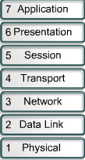
OSI Layer model
OSI: Open System interconnection
Comprises of seven layers
For network communication all network devices must speak same language or protocol.
Each layer defines how data is treated and goes through different stages while traveling in network from one place to another.
All layers are like set of instruction of assembly.
Gives complete picture of information flows within network.
All layer are used in end to end systems but only first three layers used in intermediate systems while network communication.

Slide 23
OSI layers are divided into two different sets.
Application Set
  Application set consist of Layer 5,6 and 7.
Transport set
  Consist of layer 1,2,3 and 4

Slide 24
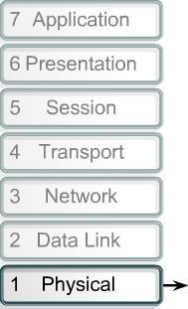

Layer 1: Physical Layer
Physical Layer
  Define physical characteristics of network. E.g. wires, connector, voltages, data rates, Asynchronous, Synchronous Transmission
  Handles bit stream or binary transmission
  Used to maintain, activate and deactivate physical link.
  For receiver it reassembles bits and send to upper layer for frames.
  For Sender it convert frames
  into bit stream and send on
  transmission medium.

Slide 25
Properties Physical Layers
Deals with bit stream.
Transmits raw bit stream over physical cable
defines cables, cards, and physical aspects
defines NIC attachments to hardware, how cable is attached to NIC
defines techniques to transfer bit stream to cable
Layer 1 Device: Repeater, Hub, Multiplexer

Slide 26
Layer 2: Data Link Layer
Maintaining, activating, deactivating data links connection.
Used to transfer data between two entities.
Used for error handling (CRC), media access control, flow control.
MAC headers and trailers are added
Two major operations:
  Concerned with physical components
  Communicate with upper layers
Turns packets into bit stream at sending station
Turns bits into Frames for upper layers at receiving layer.
Layer 2 devices: Bridges, Switches, intelligent hubs, NIC

Slide 27
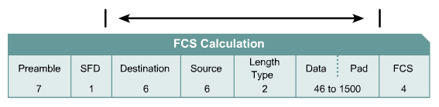
Layer 2 Frames
Frames include information about:
Which computers are in communication with each other
When communication between individual computers begins and when it ends
Which errors occurred while the computers communicated (LLC)

Slide 28
Sub layers of Layer 2
Logical link layer (LLC)
  Used for communication with upper layers
  Error correction
  Flow control
Media Access Control (MAC)
  Access to physical medium
  Header and trailer

Slide 29
Difference between Layer 1 and Layer 2
Layer 1 cannot communicate with upper layers
Layer 2 does this using LLC
Layer 1 cannot identify computer
Layer 2 uses addressing process
Layer 1 can only describe stream of bits
Layer 2 uses framing to organize bits

Slide 30
Layer 3 Network Layer
Defines network logical address (not MAC)
Provide switching and routing facilities
Determines network address and best path to deliver packets
Translate logical address into physical address
This layer responsible for:
  Addressing
  Route selection
If router cannot send data in same size as sent by source then layer 3 divides data into smaller sizes, at receiving end network layer reassembles data.
Forms Packets
Protocols that operates at layer 3:
  IP, ARP,RARP, ICMP,
Layer 3 Devices:
  Routers, ATM switches,

Slide 31
Layer 3 Packets
Packet contains following information:
Source (source IP address)
Destination (Destination IP address)
Length (length of packet)
Number (Total number of packets in message)
Sequence (sequence number of packet)

Slide 32
Layer 4 Transport
Used for data transfer between end systems.
Processes to processes delivery (not source to destination delivery)
Provides QoS
Whole message is received in order.
Converts data into segments.
Ensures data is delivered error free and in order.
Flow control: send that amount of data which can be handled by destination. Similarly if data packet lost then resend.
Protocols at layer 4: TCP, ARP,RARP, UDP
Layer 4 Network component: Gateways

Slide 33
Layer 5 Session Layer
Used for dialogue control and synchronization purposes.
Establishes sessions between systems.
Dialog control:
  Dialog between two parties for communication to take place in either half or full duplex mode.
Synchronization:
  Add synchronization points to stream of data.
  If session fails only send that data which was not delivered not whole message.
  E.g. files of 2000MB

Slide 34
Layer 6 Presentation Layer
Concerned with syntax and semantics of information.
Responsible for translation (data into bits and encoding format), compression, and encryption.
Translation: data into bits and selecting appropriate encoding technique and changing from sender format to receiver format.
Compression: Reduce number of bits.

Slide 35
Layer 7 Application Layer
Layer support Software applications to access network.
Examples: Virtual terminal (Remote desktop), FTP,TFTP, email (SMTP), Directory services, TELNET.

Slide 36
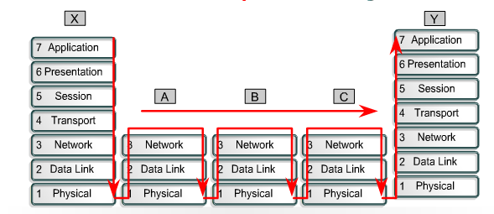

Slide 37
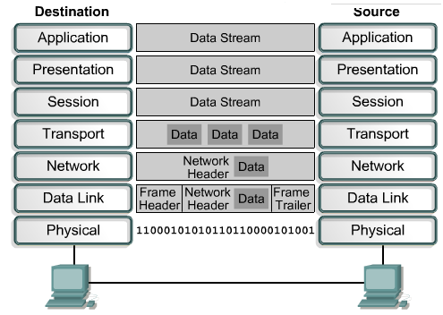

Slide 38
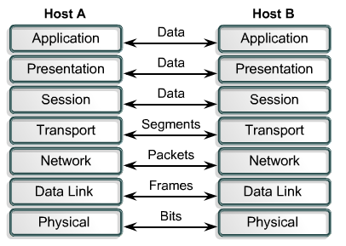
Transformation of Data in OSI layers

Slide 39
Advantages of OSI
Network communication is broken into smaller, more manageable parts.
Allows different types of network hardware and software to communicate with each other.
All layers are independent and changes does not affect other layers.
Easier to understand network communication.

Slide 40
TCP/IP
Transmission control protocol:
Guarantees end to end delivery of data segments
Arrange segments in order.
Used to check transmission errors.
Connection oriented (same route, in order) doesn’t mean circuit.
Reliable process to process communication service.
Made reliable through sequence number and acknowledgement
Internet Protocol (IP)
Data sent over internet from source to destination.
IP is connection less (packets independent, different routes, out of order).

Slide 41
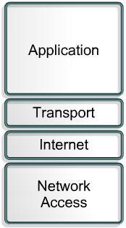
TCP/IP Layers
Application layer of TCP/IP includes
functionality of session and presentation
layer of OSI model. Like encoding, dialog
control.
Application layer includes
file transfer, email, remote login, network
Management, name management
Transport layer includes QoS, Flow control
Processes to processes communication
IP layer includes ARP,RARP, ICMP
Network layer physical link to media.

Slide 42
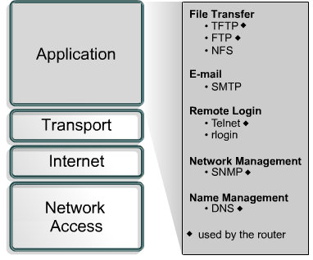
Application layer protocols with their function

Slide 43
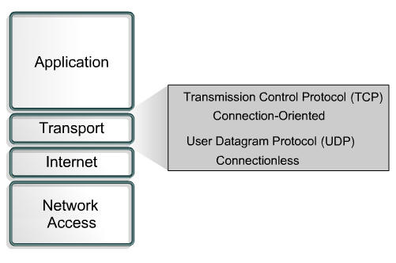
Transport layer protocols with their function

Slide 44
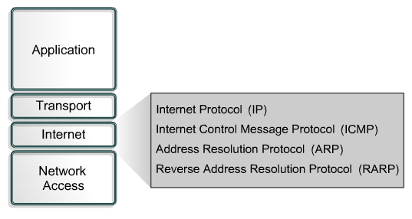
Internet layer with their protocols

Slide 45
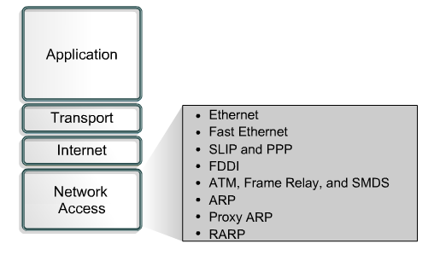
Network Access layer with their protocols

Slide 46
OSI Vs TCP/IP
Similarities include:
Both have layers.
Both have application layers, though they include very different services.
Both have comparable transport and network layers.
Both assume packets are switched. This means that individual packets may take different paths to reach the same destination. This is contrasted with circuit-switched networks where all the packets take the same path.

Slide 47
OSI Vs TCP/IP..
Differences include:
TCP/IP combines the presentation and session layer issues into its application layer.
TCP/IP combines the OSI data link and physical layers into the network access layer.
TCP/IP appears simpler because it has fewer layers.
TCP/IP protocols are the standards around which the Internet developed, so the TCP/IP model gains credibility just because of its protocols. In contrast, networks are not usually built on the OSI protocol, even though the OSI model is used as a guide.

Slide 48
Layered Protocols
Internet Protocol (IP) (Layer 3 protocol)
  Used for data communication in packet switched network
  Unreliable and connectionless (no specific path)
  Unreliable
    Data corruption
    Packet lost
    Out of order
  Packet called Datagram
  internetworking computers
  IPv4, IPv6

Slide 49
IPv4
Internet protocol version 4
Uses 32 bit address.
Possible addresses 2^32 = 4,294,967,296 (4.3 billion)
Some addresses are reserved like private addresses plus multicast addresses.
Private addresses (LANs)
  10.0.0.0 – 10.255.255.255
  172.16.0.0 – 172.31.255.255
  192.168.0.0 – 192.168.255.255
  Total reserved private addresses = 18 Million
Multicast addresses
  224.0.0.0 – 239.255.255.255
  Total multicast addresses = 270 million
Available addresses = possible addresses – (private addresses+ multicast addresses)

Slide 50
IPv6
Increase in number of addresses
128 bits long address
Possible addresses 2^128
2^96 more address then IPv4
ARP, RARP, IGMP are deleted or merged into ICMPv6 protocol.
Example : 207. 142. 131. 235. 207. 142. 131. 235. 207. 142. 131. 235. 207. 142. 131. 235

Slide 51
ARP Protocol (layer 3)
Stands for address resolution protocol
Finding physical address from logical address
Host or router transmit IP datagram packet containing logical address obtained from DNS.
Query is broadcast but reply is unicast.
Request contains sender and receiver IP plus sender physical address.
Reply contains physical address.
Proxy ARP. (router sends its physical address)

Slide 52
...
ARP is used in four cases of two hosts communicating:
  When two hosts are on the same network and one desires to send a packet to the other. (same network)
  When two hosts are on different networks and must use a gateway/router to reach the other host (internet)
  When a router needs to forward a packet for one host through another router. (internet)
  When a router needs to forward a packet from one host to the destination host on the same network. (internet)
Reverse of ARP
Finding logical address from physical address
Request broadcast to network.
Based on Client server protocol.

Slide 53
ICMP (Layer 3)
Used to report errors with delivery of IP data.
  E.g. if particular service or host not reachable or to check routers are correctly routing .
Ping tool uses ICMP to check host is reachable and how long it takes to reach.
ICMP message is delivered in IP packet.
Error reporting not error correction.
Two types of messages
  Error reporting message
    Problems with router or host e.g. destination unreachable, time exceeded, parameters problem
  Query message
    Help in getting specific information. e.g. neighbors

Slide 54
ICMP Errors
Network Errors:
  Host or network unreachable
  Network congestion message:
    When router buffers too many packets, and don’t process with same speed as received, generates source quench message. Too many messages results congestion.
  Time exceed
    ICMP timeout message is generated when host is unreachable.
    If errors in routing table, packets travel in loop. At each router value is decremented by 1.
    When TTL value reaches to 0, packet discarded with ICMP error.
    TTL value is default

Slide 55
IGMP Layer 3
Internet group management protocol
  Protocol involved in multicasting.
  Protocol that manages group membership.
  Provides information to multicast routers about the membership status of hosts.
  Router receives thousand of multicast packets, if destination unreachable broadcast packets. Increases traffic load.
IGMP help router in providing this information.
Agent maintains, edit membership and provide information of group.

Slide 56
IGMP (contd…)
IGMP has following messages
  Query
    Request for information of hosts
  Joining report
    If one process in group sends membership report.
  Leaving report
    When no other processes in company

Slide 57
BOOTP and DHCP
BOOTP
Acquire IP automatically
It enables diskless workstations to
  Discover it IP address
  Discover IP of BOOTP server
  Load file into memory for booting
DHCP
Clients obtain following automatically
  IP address
  Default gateway
  Subnet mask
  IP address of DNS server

Slide 58
...
DHCP address allocation
Manual allocation
  Table is configured at server with MAC addresses manually
Automatic allocation
  Permanently assigns IP from free IP addresses range
Dynamic allocation
  Dynamic reuse IP addresses using TCP/IP software configured at client.

Slide 59
TCP Layer 4
Transmission control protocol
Used for exchange of data with applications.
Reorders data
Divides data into segments of equal sizes.
Applications send octets to TCP for transmission, TCP divides into equal segments.
TCP keeps check that if bytes are damaged, through checksum.
Sender and receiver both check damaged bytes.

Slide 60
TCP Packet fields
Source: 16 bit
Destination: 16 bit
Sequence number: 32 bit
Acknowledgement number: 32 bit, receiver increment by 1 as acknowledge.
Header: 20-60 bytes
Reserved: 6 bits
Control: 6 different bits

Slide 61
UDP
Minimum overhead.
Used to send short messages.
Not reliable as TCP (out of order, missing datagram, , duplicate datagram).
Lack of flow control and error control
Faster and efficient
Communication takes place using ports.
Header contains following information:
  Source port number (16 bits)
  Destination port number (16 bits)
  Total length(16 bits)
  checksum(16 bits)
Pseudo header contains rest of information about source address, destination address, etc

Slide 62
DNS Layer 7
Domain name system
Stores information about hosts
Maps names of hosts into IP addresses.
E.g. google.com is the name space,
Domain name can have tree like structure.
Resolver sends DNS request to DNS server.
Domain should be unique, but duplication among domains is possible.
Resolver request sent to server, if cannot resolve then referred to another server.
Mail.google.com: level three doamin
There can only be 127 levels each level can have 63 characters
Lists are maintain by the registrars.
Mainly domain name has two parts
  Rights most represent toop level domain
  Left specifies subdomain
Every domain has one or more domain name server

Slide 63
Modes of transmission
Unicast
  Information sent from one sender to one receiver
  Use standard unicast applications e.g. ftp, http, smtp and telnet
Broadcast
  Information sent from one sender and all other connected receiver
  ARP uses broadcast to resolve address
  255.255.255.255
Multicast
  Information sent from one or more sender to a particular set of users.
  E.g. video server transmitting TV channels

Slide 64
Transmission Impairment
Attenuation
Propagation delay
Distortion
Noise
Crosstalk
Jitter

Slide 65
Attenuation
Reduction in strength of signals
Also referred as Loss
Signals traveling on long distance looses their strength.
Signals losses some of their energy and signals are converted into heat.
Represented in Decibels
Cables measured in ‘decibels per foot’.
More efficient cable = less attenuation per unit distance.
Repeaters are used to overcome attenuation.
Repeaters regenerates signals.

Slide 66
Propagation delay
Delay from the time signal transmitted and the time signal received.
Measured in milliseconds.
Varies from medium to medium
Distortion
Change in shape of signal

Slide 67
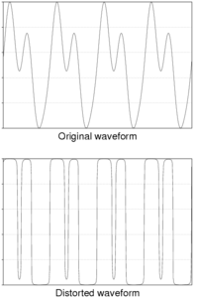
Distortion

Slide 68
Noise
Addition of external factors in signals
Noise can disturb data.
Two wires can generate voltage noise which affects data.
Noise which corrupts data can be:
  Thermal noise (signals generated by electrons by random motion)
  Induced noise (generated by motors and appliances)
  Crosstalk (affect of one wire on another)
  Impulse noise (generated by power lines)

Slide 69
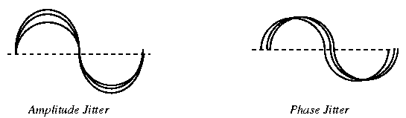
Crosstalk & Jitter
Crosstalk
One line induces signal into another
Mostly happens in pair cables.
Jitter
Variation in the signals or data packets at destination with variation of time. E.g. application at destination is time sensitive like audio or video stream.
Jitter can be of two types
  Amplitude jitter
    Small constant change in amplitude, can be caused by power noise
  Phase jitter
    Small constant change in phase of signal,

Slide 70
Performance
Bandwidth
  Bandwidth in hertz
    Range of frequencies contained in signal
  Bandwidth in bits per second
    Number of bits per second a channel or network can transmit
Throughput
  How fast a data can be sent through a network
  Bandwidth and throughput are different
  Link with bandwidth 1Mbps but device can only process 200 Kbps.
Latency
  Delay between the message transmitted and message received.
Latency can be caused due to:
    Propagation time
    Transmission time
    Queuing time
    Processing time.

Slide 71
...
Propagation time
  Time required by bit to travel from source to destination
  That is total distance per unit speed
Transmission time
  Time required to send complete message
  Measured in message size per unit bandwidth available
Queuing time
  Time required by intermediate device to processes data.
  varies with load on network.
  E.g. packets queuing

Slide 72
Transmission media
Two types of media
  Guided
    Uses cabling system to guide data signals to a specific path.
  Unguided
    Data signals travels not to a specific path.
Types of Guided media
  Open wire
  Twisted pair
  Coaxial cable
  Optic fiber

Slide 73
...
Important consideration related to cables performance:
  Speed for data transmission
  Digital (Baseband) or analog transmission
  How far signal travels before it gets attenuated.
Specification related to cable type are:
  10BASE-T
  10BASE5
  10BASE2

Slide 74
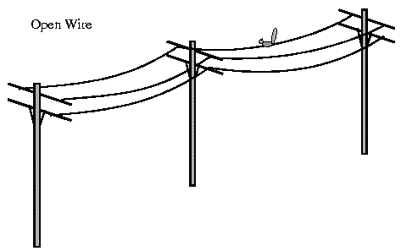
Open wire
Open electric wires
No shielding or protection from external noise
Cannot be used for data transmission but for less distances.

Slide 75
Coaxial cable
Outer shield protects inner shield from outer electric signals.
Similarly insulator between two conductors protects them from noise generated by either conductor.
Cable has 10 – 100 Mbps speed
Inexpensive
Maximum cable length 500m.
Coaxial cable offers several advantages for LAN.
Run longer distance then other cables.

Slide 76
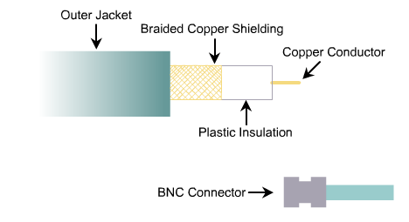
...

Slide 77

Twisted pair
Wires are twisted in pairs
Each pair carries +ve and –ve signals
Noise appearing on one wire will also occur on other wire of same pair.
Noise appeared on both wires of pair will cancel its affect.
Twists of pair cancels the noise affect.
Increase in the number of turns per foot reduces noise interference.

Slide 78
...
Types of Twisted pair
Shielded twisted pair
  STP cable combine the techniques of cancellation, shielding and twisted wires.
  Each pair wrapped in metallic foil, then two pairs are wrapped in overall metallic foil.
  STP reduces
    Electric noise within pairs and outside noise
    crosstalk
  STP provide protection from all kind of noises
  It is expensive and hard to install.
0 – 100 Mbps Speed
Maximum cable length 100m before signals attenuated.

Slide 79
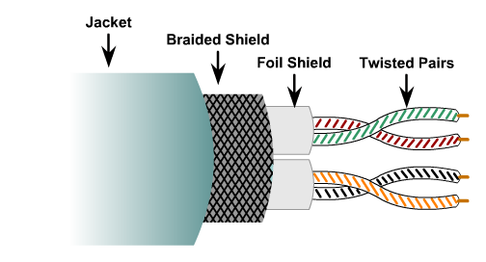
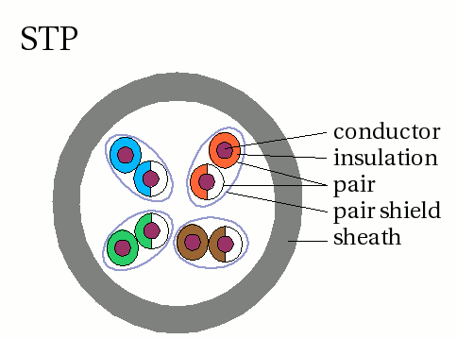
Shielded twisted pair

Slide 80
Unshielded Twisted pair
Eight cables, Four pairs
Each cable is covered with insulating material
Each pair is twisted around each other for cancellation effect.
Advantages include
Speed 10 – 100 – 1000 Mbps (depend on category)
Les expensive and easy to install.
Maximum length 100 m
Uses RJ-45 connector.
Electric noise may occur.

Slide 81
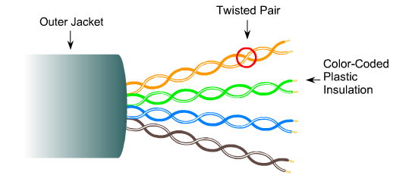
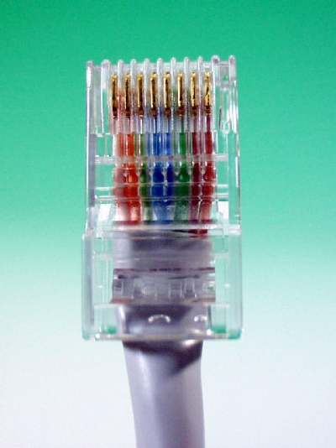
Unshielded Twisted pair

Slide 82
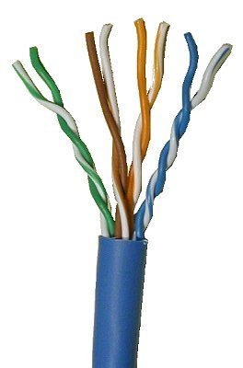
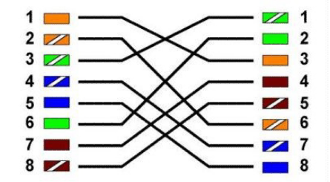
UTP cable
Straight through cable (different devices)
Crossover cable (similar devices)
Rollover cable (RJ-45 to DB-9)

Slide 83
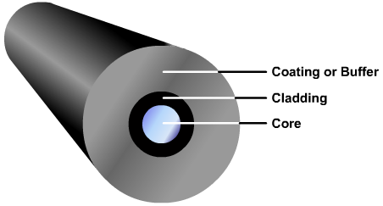
Optical Fiber
Data or information is transmitted as light pulses.
Carries more data for longer distances and much more speed as compare to other media.
Requires more protection.
There are two modes of optical fiber.
Multimode
Single mode
Multimode used for short distances whereas single mode is used for longer distances.

Slide 84
Optical Fiber
Optical fiber is not affected by outer noise.
No crosstalk.
Attenuation is caused by tight bends
Bends causes cracks in the cladding and light rays are scattered.
Scattering, absorption, dispersion, improper installation causes fiber losses.

Slide 85

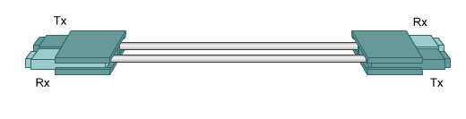
Multimode optical fiber
Multimode operates at multiple beams.
core in diameter is larger.
Multimode has two forms:
Step index optical fiber
Graded index
Two glass fibers are used for two way communication.
Carries data up to 2000m.

Slide 86
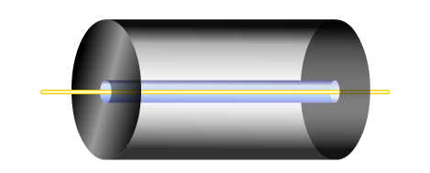
Single mode Optical fiber
Only allows one beam of light to travel
Core is smaller in diameter.
Light beam travels in the middle of the core.
Single mode has higher data rates and greater speed.
Single mode can carry data up to 3000m.

Slide 87
Unguided media
Based on electromagnetic waves
Do not use any physical conductor
Signals are broadcast
Electromagnetic spectrum
  Radio waves & micro waves :3kHz to 300GHz
  Infrared waves: 300GHz to 400GHz
Ways in which signals travel from source to destination.
  Ground propagation (low frequency signals)
  Sky propagation (higher frequency signals, reflected back to earth)
  Line of sight propagation (very high frequency signals, diected from antenna to antenna)

Slide 88

Multiplexer
Make good use of available bandwidth.
Simultaneous transmission of multiple signals across a single data link.
n lines share the bandwidth of one link.
Saves cost of multiple channels.
We combine mux and De-mux into a single unit.
Types of multiplexer
Frequency division
Time-division
Wavelength division

Slide 89
Frequency division
When bandwidth (Hz) of link is greater then combined bandwidth of signals.
Each sending device modulate Signals at different carrier frequency.
Modulated signals are combined into a single signal.
Channels are formed through which various signals travel.
MUX
Channel 1
DE
MUX
Channel 2
Channel 3

Slide 90
Wavelength-Division multiplexing
Designed to use high data rates like optical fiber.
Multiplexing allows to combine several lines into one.
Same as FDM but operates optical signals instead of frequency signals.
λ1
MUX
DE
MUX
λ1
λ2
λ2
λ3
λ1
λ2
λ3
λ3

Slide 91
Time division multiplexing
Instead of sharing portion of bandwidth as in FDM, time is shared.
Each connection occupies a portion of time in link.
1
MUX
DE
MUX
1
2
2
3
3
Data flow

Slide 92
Spread Spectrum
We combine different sources to fit in larger bandwidth.
But used in wireless applications.
Wireless application uses air as medium for communication.
Frequency of transmitted signal varies which results in higher bandwidth then required.
So it spreads the original spectrum.
conventional wireless systems remains at a fixed frequency. E.g. 101 MHz not goes upto 105Mhz, location can be identified.
Two types
Frequency hoping spread spectrum
  Signal is modulated by set of frequencies to expand bandwidth.
Direct sequence spread spectrum
  Each bit is assigned a code of n bits to increase the bandwidth.

Slide 93
IPv4 Addressing
Class A addresses begin with 0xxx, or 1 to 126 decimal.
Class B addresses begin with 10xx, or 128 to 191 decimal.
Class C addresses begin with 110x, or 192 to 223 decimal.
Class D addresses begin with 1110, or 224 to 239 decimal.
Class E addresses begin with 1111, or 240 to 254 decimal

Slide 94
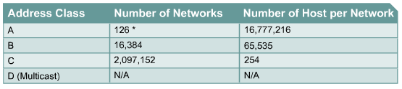
Parts of IP address belong to Network
Class A -- NNNNNNNN.nnnnnnnn.nnnnnnnn.nnnnnnnn
Class B -- NNNNNNNN.NNNNNNNN.nnnnnnnn.nnnnnnnn
Class C -- NNNNNNNN.NNNNNNNN.NNNNNNNN.nnnnnnnn
Each network IP has two parts
  Network where system is connected
  System itself

Slide 95
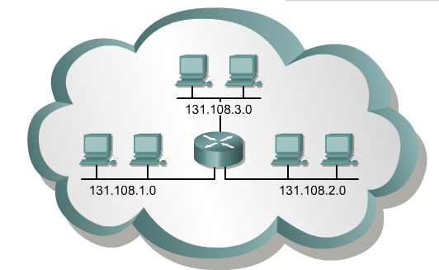
Subnetting
Dividing and identifying separate networks through LANs
Prevents complete address exhaustion.
Break into smaller pieces

Slide 96
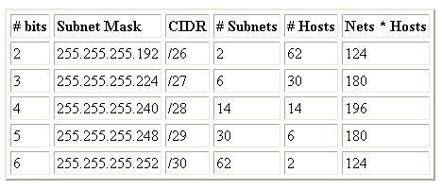
2n-2 is the formula used to calculate total number of subnets and nodes.
CIDR: Classless InterDomain Routing
Example: we need 32 IP

Slide 97
Datagram Networks
Each message transmitted is converted into different packets of same sizes.
Each packet is treated independently.
Packets in this approach are referred to as datagram .
Do not follow same path.
Reach at destination in out of order.
Datagram are connectionless.
No setup or teardown phases.
Routing table is used to send packets from source to destination.

Slide 98
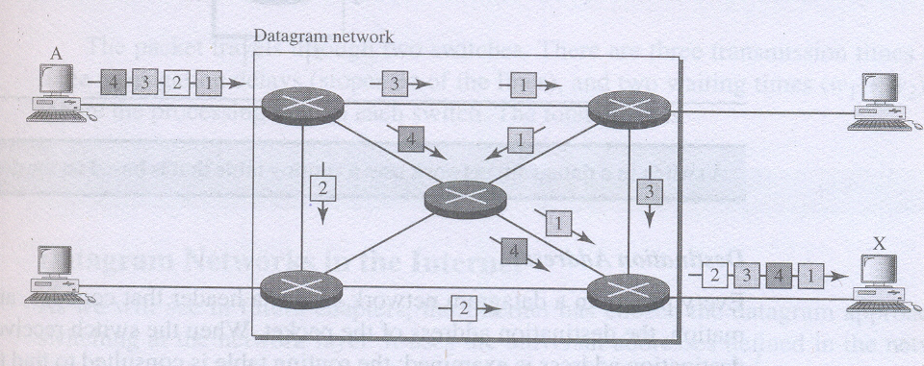
Case study

Slide 99
Efficiency: better then circuit switching network.
Resources can be controlled, only used when transmitting packets.
Delay: datagram network has greater delay then circuit switching network.
Have to wait at each switch before transmission.

Slide 100
Virtual circuit networks
Combination of circuit and packet switching networks.
Has following properties.
  Setup and teardown connection, like circuit switching, before data transfer.
  Resources are allocated during setup phase (circuit) or on demand (packet).
  Data is divided into datagram packets.
  But all packets follow same path.
Has following processes.
  Setup
  Data transfer
  Acknowledgement
  teardown

Slide 101
Random Access method
Each station is independent and can send data at any time.
Has different protocols
  ALOHA
  CSMA/CD
  CSMA/CA
ALOHA
  Developed earlier in 1970
  Each station can sends frame at any time.
  There is only one channel
  Collision possible.
  ALOHA relies on acknowledgements
  If ACK not received after time out period sender assumes frame destroyed it resends.
  If all nodes resend at same time again collision possible.
  So each station waits for random amount of time.

